Slide 1

Oil Price Prediction
Group: 4
Mentors : Dhanyapriya & Karthik

Slide 2

Team members
Harish Gone
M Sivasankari
Vivek
Chetan Bhat
Yogana Gowda B P
Dhairayasheel Dinesh Sadupatil
Arunesh Ankit

Slide 3
Objective
Oil is a product goes completely in a different direction for a single market event as the oil prices are rarely based on real-time data, instead, it is driven by externalities making our attempt to forecast it even more challenging.
As the economy will be highly affected by oil prices our model will help to understand the pattern in prices to help the customers and businesses to make smart decisions.

Slide 4
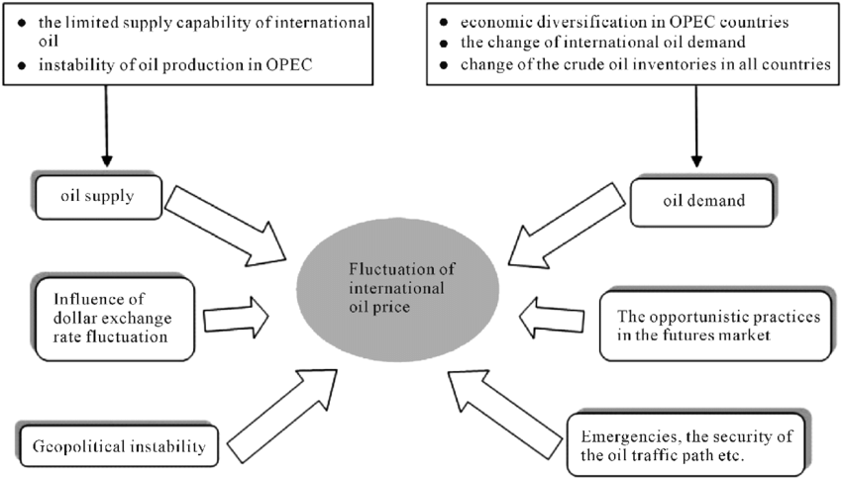
Factors Affect the oil price

Slide 5
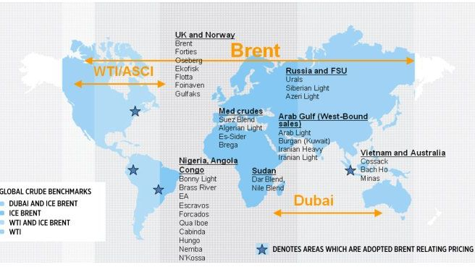

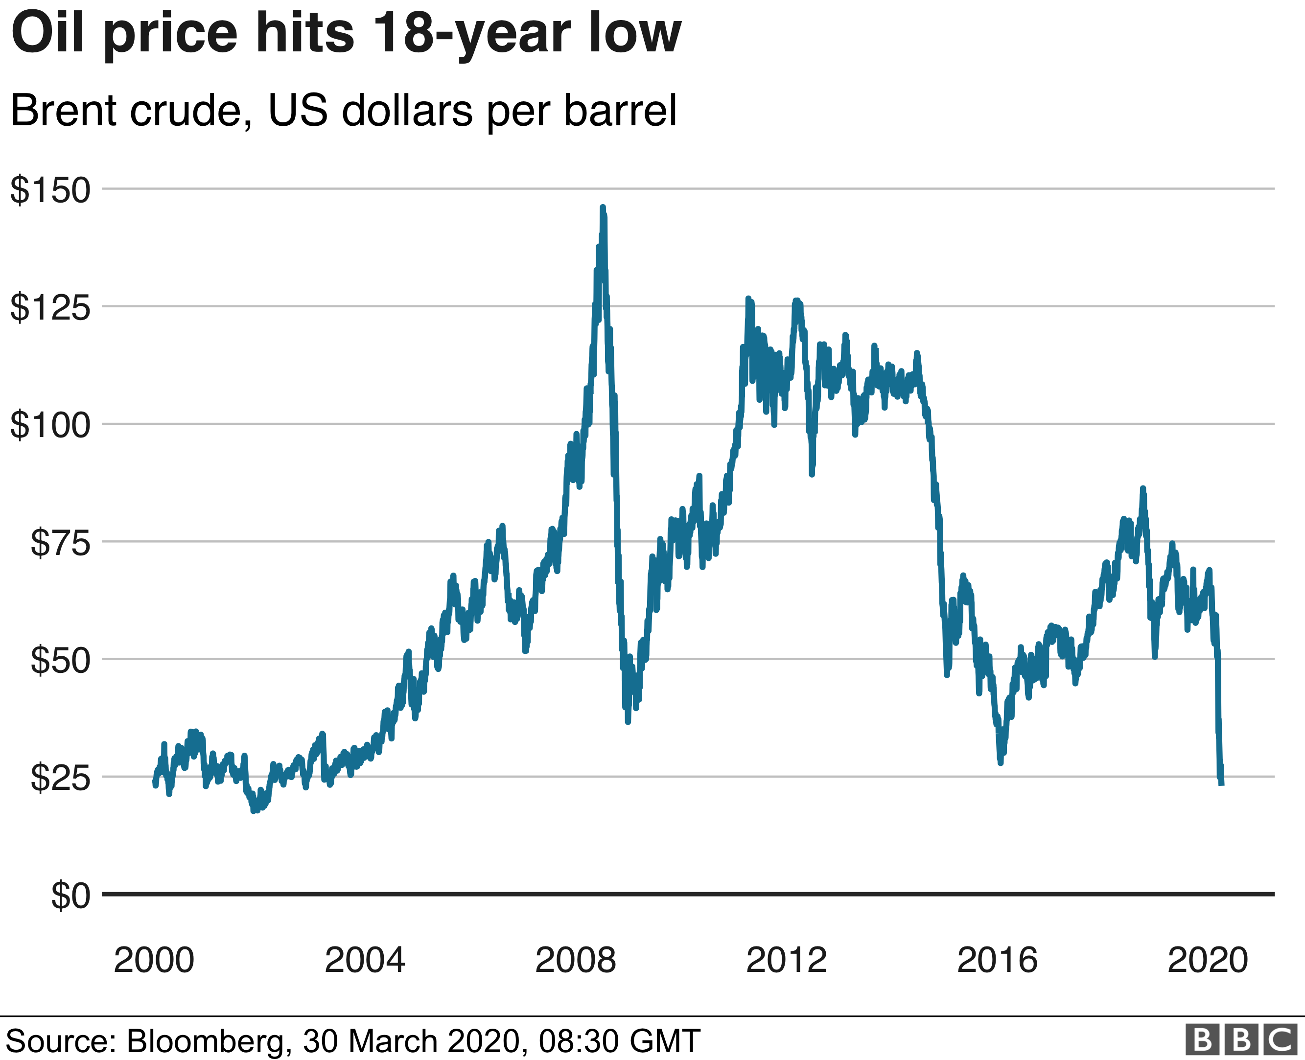
A benchmark crude is a crude oil that serves as a reference price for buyers and sellers of crude oil.
There are three primary benchmarks
West Texas Intermediate (WTI)
Brent Blend
Dubai Crude

Slide 6
Project architecture / project flow
Data collection
Explore & visualizations
Data processing
Partition series
Model building
Evaluate & compare performance
Deployment

Slide 7
Data collection

Slide 8
Dataset
Downloaded the brent oil price dataset from U.S. Energy information administration (EIA) website.
Dataset consist of 20 May 1987 to 19 Dec 2022 (36 years) of daily oil price.

Slide 9
Explore & visualizations

Slide 10
Inferences from Data-Set
DATASET
9034 Rows 2 Columns
Data Types
Datetime Float
Missing Values
Not Present in the dataset
Duplicated Rows
No duplicated rows

Slide 11
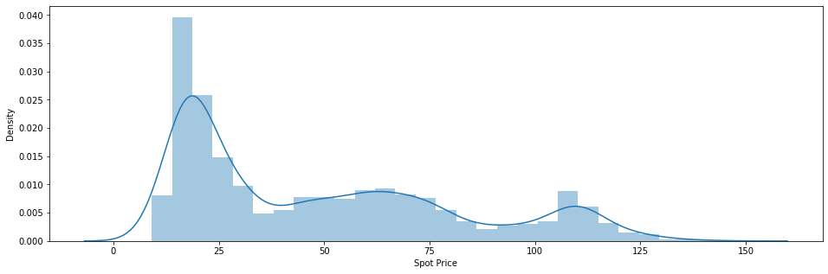
Histogram and Distribution Plot
Inferences :
Most frequent values of brent are in the range of 10 to 25.
The brent oil price values from 0 to 40 are less frequent.
It show the data doesn't follow normal distribution.
Right skewed data

Slide 12
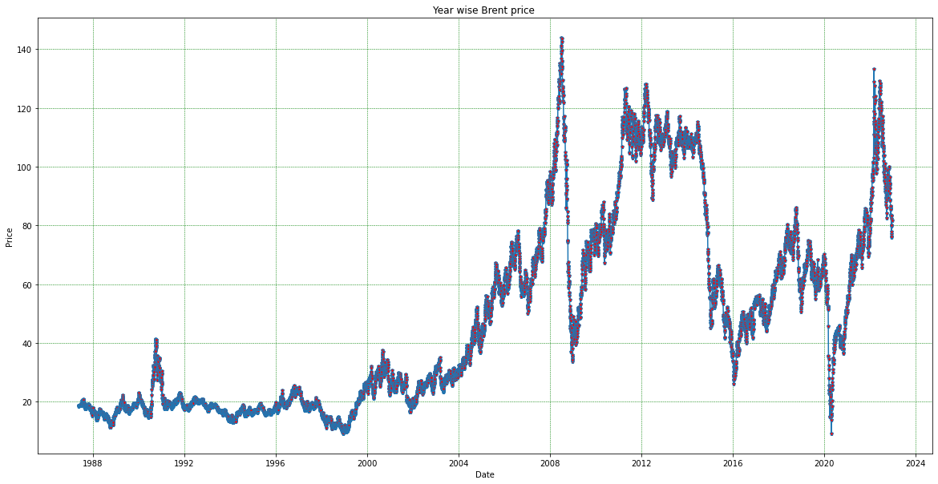
Line plot
Inferences :
Trend:
The price was steady increasing till 2009($40 to $120).
The price has dropped significantly in 2010 because of global recession hit.
At the beginning of 2020, oil prices then again declined by due to covid.
It was observed that after the drop, towards the beginning of 2021 price started to climb to precovid numbers.
Seasonality :
We can see some weak seasonality from the data.

Slide 13
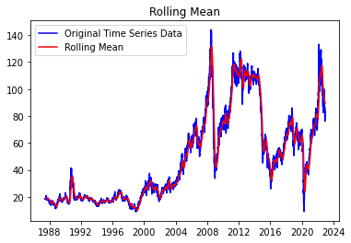
Stationarity: As the mean is changing in different time period we can say the data is not stationary.

Slide 14
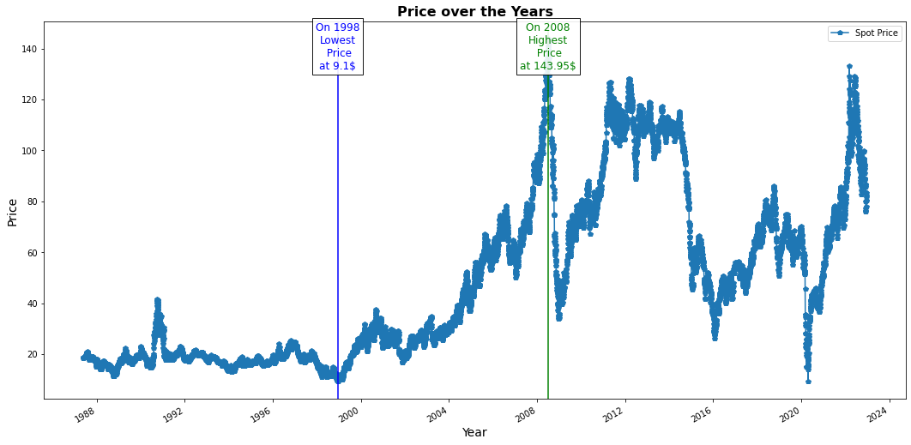
Lowest and Highest price
In the above plot that the lowest price was recorded at 1998 which is 9.1$ and the apex of the price was at 2008 which is 143.95$.

Slide 15
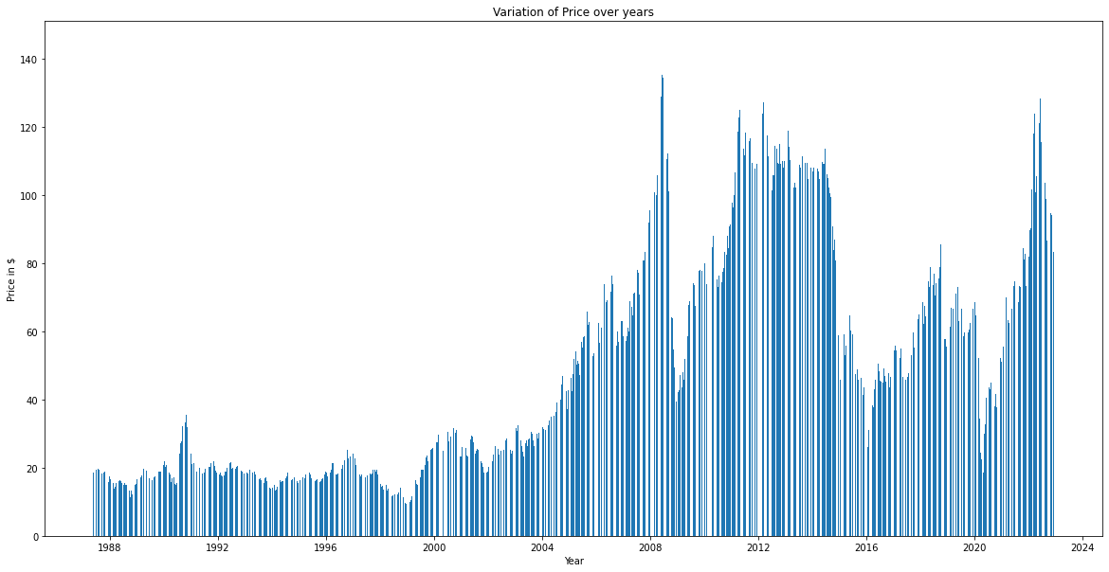
Barplot

Slide 16
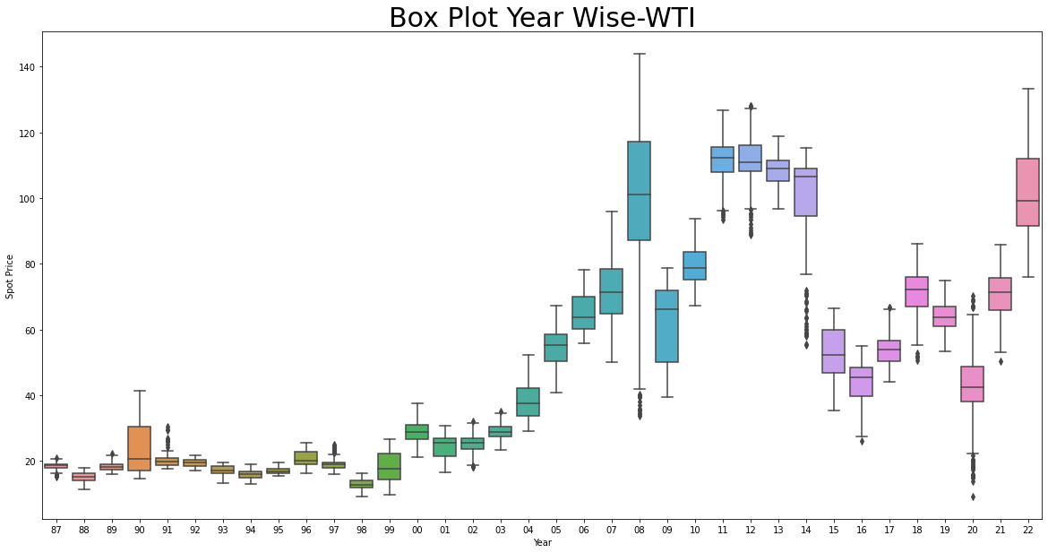
Boxplot Year Wise
Inferences :-
Oil prices fell from high of $143.95 in June 2008 to a low of $39.09 in February 2009.
The lower price for oil due to the financial crisis was the major impact on the sector
2017(june) to 2018 (oct) was the boom year for oil market.
2018
The price of oil dropped in November 2018 because of number of factors, including "rising petro-nations' oil production, the U.S. Shale oil boom, and swelling in north American oil inventories," according to market watch.
2020
As rising covid cases prompted fears of demand slowdown, due to that the price of the oil dropped

Slide 17
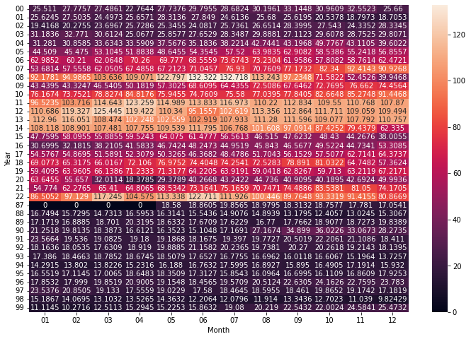
Heatmap
The darker the colour the lesser the value and lightest the colour the highest the value.
The all time high prices can be seen in recent months post epidemic in the month of June 2008 as high as 132.322 with continuation of rally in following month of July 2008 with price 132.718.
The all time lowest prices in the month of Dec 1998 as low as 9.82429.
Finally, we can say that the prices are getting normal and touching highest which is a good symbol that now we have a stable demand of crude oil.

Slide 18
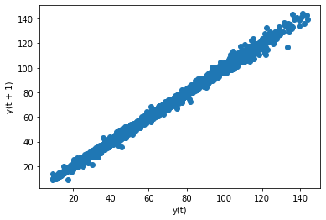
Lag Scatter Plot
A lag plot is a special type of scatter plot in which the x-axis represents the dataset with some time units behind or ahead as compared to the y-axis.
The difference between these time units is called lag.
Inferences :-
Lag plot indicates that oil prices had good positive correlation relationship.
Hence,this series is good for time series modelling as its showing autoregressive nature.

Slide 19
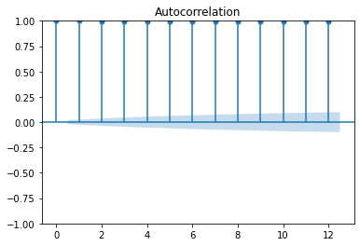
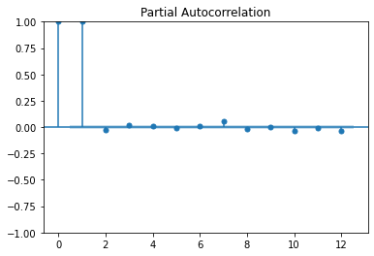
Autocorrelation
To check the autocorrelation between the lagged values( yt - yt-1 ) at any stage is strong enough to build a model we will use the concept of
ACF (Autocorrelation Function)
PACF(Partial Autocorrelation Function)
In this plot, the two dotted lines on either sides of 0 are the confidence intervals. These can be used to determine the ‘p’ and ‘q’ values as:
p – The lag value where the PACF chart crosses the upper confidence interval for the first time. If you notice closely, in this case p=1.
q– The lag value where the ACF chart crosses the upper confidence interval for the first time. If you notice closely, in this case q=1.

Slide 20
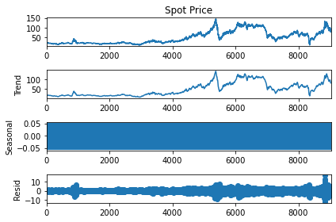
Decomposition plot

Slide 21
Data Processing

Slide 22
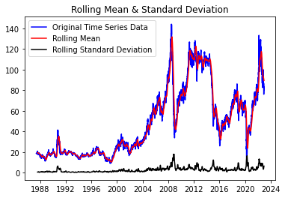
Stationarity
A Stationary series is one whose statistical properties like mean, variance,do not vary with time
Check for Stationarity
Plotting Rolling Statistics:
Plot the moving average or moving variance and see if it varies with time
Dickey-Fuller Test:
One of the statistical tests for checking stationarity.
Results of Dickey-Fuller Test:
Test Statistics -2.122381
p-value 0.235611
#Lags Used 29.000000
Number of Observations Used 9004.000000
Critical Value 1% -3.431076
Critical Value 5% -2.861861
Critical Value 10% -2.566941
dtype: float64
From the above information we can say that data is non stationary .
p-value > 0.05: Accept the null hypothesis (H0), the data has a unit root and is non-stationary.
p-value <= 0.05: Reject the null hypothesis (H0), the data does not have a unit root and is stationary.

Slide 23
Converting non stationary to stationary
Date
1987-05-20 NaN
1987-05-21 -0.18
1987-05-22 0.10
1987-05-25 0.05
1987-05-26 0.03
...
2022-12-13 2.14
2022-12-14 3.19
2022-12-15 -0.99
2022-12-16 -2.14
2022-12-19 1.46
To convert non stationary to stationary we have used differencing technique.
In differencing we subtract the values of the series with the values of the previous time periods

Slide 24
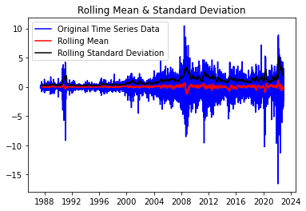
Checking Stationarity with Dickey-Fuller Test after Differencing
Results of Dickey-Fuller Test:
Test Statistics -1.553166e+01
p-value 2.216477e-28
#Lags Used 2.800000e+01
Number of Observations Used 9.004000e+03
Critical Value 1% -3.431076e+00
Critical Value 5% -2.861861e+00
Critical Value 10% -2.566941e+00
dtype: float64

Slide 25
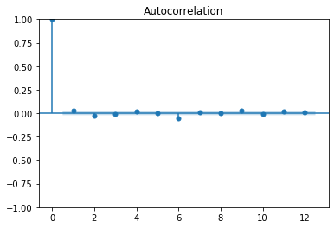
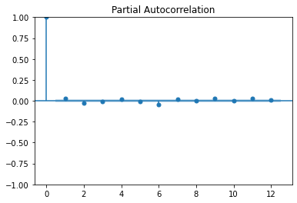
ACF and PACF plot after differencing
In this plot, the two dotted lines on either sides of 0 are the confidence intervals. These can be used to determine the ‘p’ and ‘q’ values as:
p – The lag value where the PACF chart crosses the upper confidence interval for the first time. If you notice closely, in this case p=0
q– The lag value where the ACF chart crosses the upper confidence interval for the first time. If you notice closely, in this case q=0

Slide 26
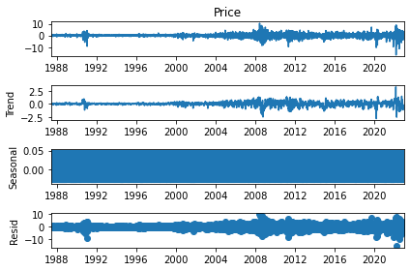
Decomposition plot after differencing

Slide 27
Partition Series

Slide 28
Splitting the data into test and train
The final data after data processing was split into train data and test data
Training data :8400
Test data :634

Slide 29
Model building
Model | Mape Value
SARIMA | 1.0837
LSTM | 2.8545
FB Prophet | 0.7727
Holt | 33.617
Holt Winter | 37.529
The Forecast model was build based on SARIMA,LSTM and FB Prophet Models has it gives the least MAPE value

Slide 30
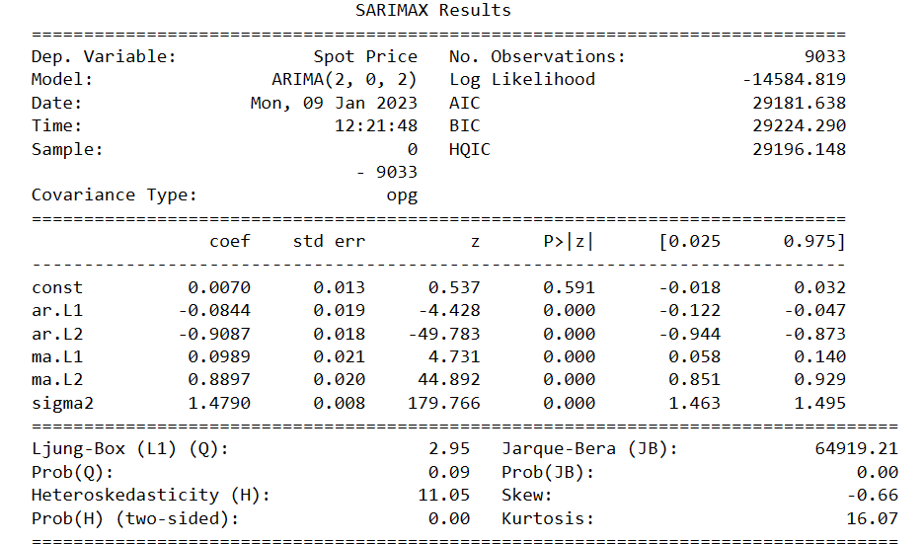
SARIMA Model Summary

Slide 31
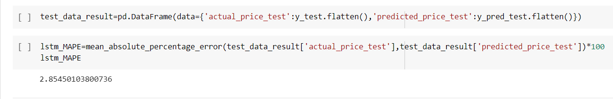
LSTM Mape Value

Slide 32
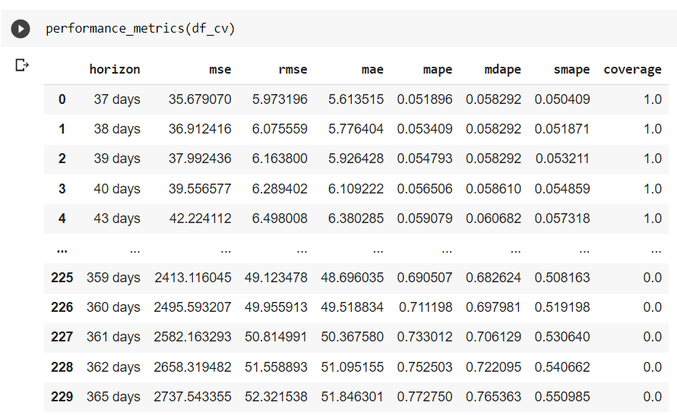
Fb Prophet Mape Values

Slide 33
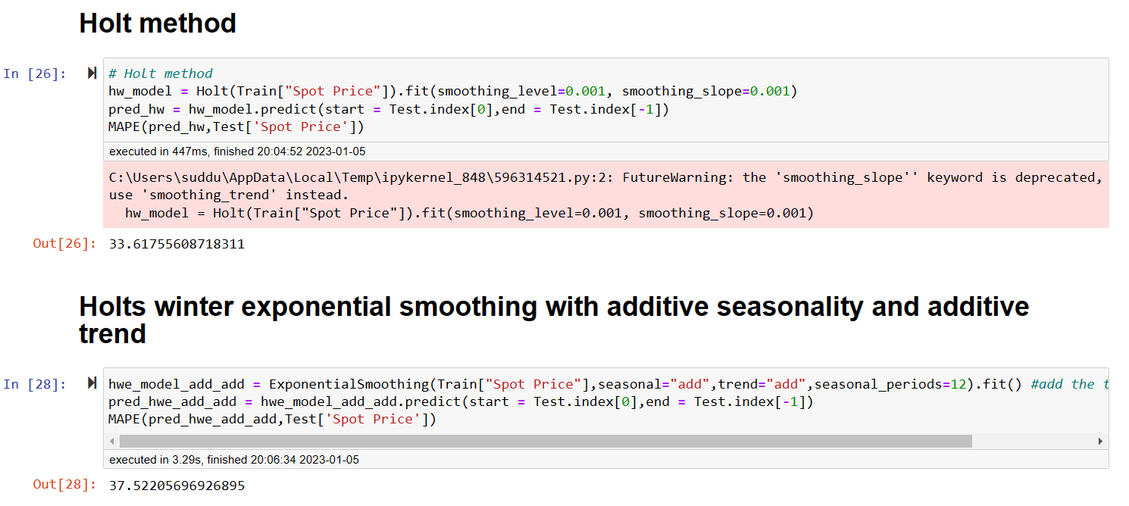
Holt and Holt Winters Mape Values

Slide 34
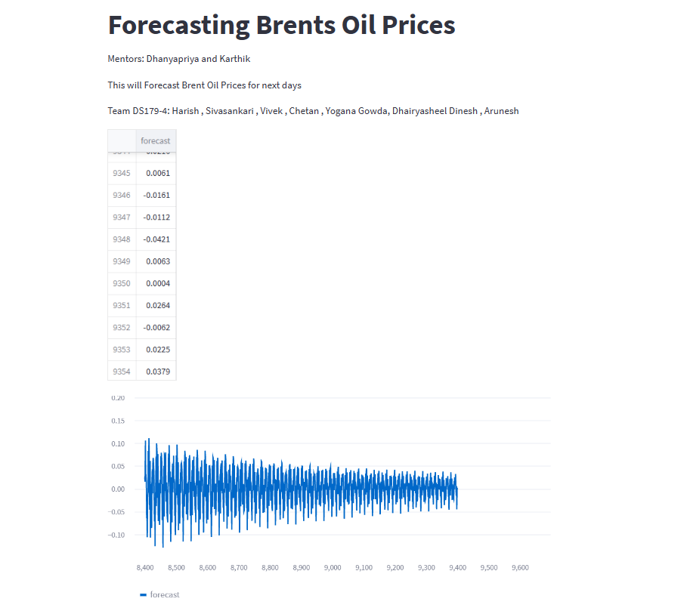
Model Deployment Using Streamlit

Slide 35
CHALLENGES FACED
Stationarity check
Insights into ACF and PCAF plots
CHALLENGES
Model Building
Increasing Model accuracy

Slide 36
CONCLUSION AND IMPROVEMENTS
It can be inferred that on the whole a SARIMA model provides the good result in terms of accuracy for the given dataset.
To make the data stationary , differencing method gave the least p-value.
The above improvements have helped in getting a good accuracy for the final model.

Slide 37
THANK YOU

